Slide 1
Overlay Tunnels
Learning Outcomes:
Security Fundamentals
Generic Routing Encapsulation (GRE)
IP Security Fundamentals (IPSec)
Cisco Locator/ID Separation Protocol (LISP)
Virtual Extensible Local Area Network (VXLAN)

Slide 2
1. Security Fundamentals
confidentiality: only sender, intended receiver should “understand” message contents
authentication: sender, receiver want to confirm identity of each other
message integrity: sender, receiver want to ensure message not altered (in transit, or afterwards) without detection
non-repudiation: no one (including the sender) can deny that message was sent by the sender
access and availability: services must be accessible and available to users

Slide 3
2. Generic Routing Encapsulation (GRE)
Overlay network is a logical or virtual network built over physical transport network known as underlay network.
Virtual Private Network (VPN) is an overlay network that enables private networks to communicate over untrusted underlay network (Internet).
Generic Routing Encapsulation (GRE)
Tunneling protocol that provides connectivity to variety of network-layer protocols by encapsulating and forwarding over IP networks.
Can be used to tunnel through Firewall or ACL.
Used as duct tape to connect discontiguous networks or bad routing designs.
Most importantly used to create VPNs.
Protocol over which GRE is built is Transport protocol, such as IP.
Protocol that uses GRE tunnel is known as passenger protocol, such as IPV4,IPv6, OSPF,EIGRP.
Deep Dive ?

Slide 4
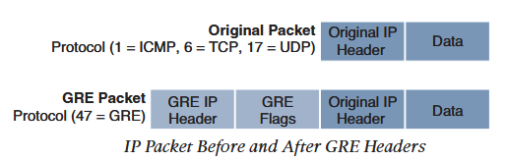
2. Generic Routing Encapsulation (GRE)
GRE Encapsulation: Adds new header(GRE header) over IP packet (IP header + payload)
GRE De-encapsulation: Strips off the GRE header exposing IP packet (IP header + payload)
Original IP header could be IPV6 packet (Passenger protocol)
GRE as a Carrier protocol encapsulates IPV6 packet with GRE header.
GRE then encapsulates whole resulting packet with Transport protocol header (IPv4).
Uses protocol number 47 in IP header

Slide 5
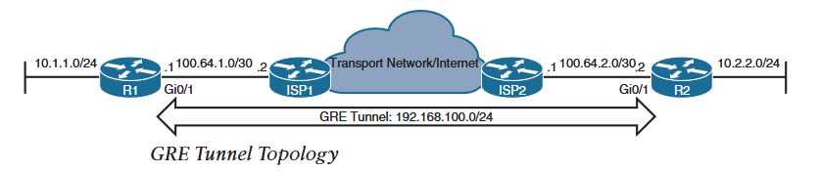
2. GRE Configuration
R1:
! Create tunnel in global configuration
interface Tunnel 10
! general description, make it sensible
description tunnel-to-R2
! (Opt.)Bandwidth of tunnel in Kbps, virtual interface don't have bw, this is used for best path calculation in routing protocols.
bandwidth 1000000
! IP address of the overlay tunnel
ip address 192.168.100.1 255.255.255.0
! (Opt.)GRE encapsulation adds header bytes(Min. 24)
ip mtu 1400
! (Opt.)Tunnel keepalive and retry value to keep the tunnel up
keepalive 5 3
! Source IP/interface of the transport protocol,this ip is used to encapsulate/de-encapsulate GRE tunnel. Use loopbacks for stability
tunnel source GigabitEthernet0/0
! Destination IP of the transport protocol toward which the encapsulated packets are sent to.
tunnel destination 100.64.2.2

Slide 6
2. GRE Configuration
R2:
interface Tunnel10
description tunnel-to-R1
bandwidth 1000000
ip address 192.168.100.2 255.255.255.0
ip mtu 1400
keepalive 5 3
tunnel source GigabitEthernet0/0
tunnel destination 100.64.1.1
Recursive Routing can occur in GRE tunnel when the route to tunnel endpoints is learned via tunnel itself.
Tunnel comes up with default static route in RIB towards ISP to reach tunnel endpoint.
OSPF misconfigured on R1 that will include 100.64.1.0/30 network. R1 won't form adjacency with ISP1 but will form with R2 over the tunnel.
Router will prefer OSPF route over default static route as it is more specific. R1 installs OSPF route in RIB.
Routers can identify such scenario and generate syslog messages and tears down the tunnel. Which removes OSPF route from RIB and installs static default route.
%TUN-5-RECURDOWN: Tunnel10 temporarily disabled due to recursive routing
Above process repeats forever until the OSPF misconfiguration is removed.

Slide 7
3. IPSec Fundamentals
IPSec is a framework of open standards to create highly secure VPN tunnels.
IPSec provides below security services to make the VPN tunnel highly secure.
Services | Description | Methods Used
Peer Authentication | Identity Verification | Pre-Shared Keys Digital Certificates
Confidentiality | Encryption of plaintext data to ciphertext. Prevents eavesdropping. | Data Encryption Standard /Triple (DES/3DES) Advanced Encryption Standard(AES) DES/3DES not recommended.
Integrity | Prevents data tempering/alterations with Man-in-the-Middle (MitM) attacks | Hash Message Authentication Functions (HMAC) Message Digest 5 (MD5) Secure Hash Algorithm (SHA1,SHA256,SHA384,SHA512) MD5 not recommended
(Replay Detection) | MitM can replay the messages(ciphertext) appearing as a genuine sender. | Sequence numbering the messages.

Slide 8
3. IPSec Fundamentals
IPSec Offers security services in two modes:
Authentication Header (AH)
Only provides authentication, data integrity and replay detection.
No mechanism of encryption and does not support Network Address Translation Traversal (NAT-T).
Uses protocol number 51 in IP header.
Encapsulating Security Payload (ESP)
Provides encryption, Integrity, replay detection and authentication.
Supports NAT-T and uses protocol number 50 in IP header.
IPSec can operate in two modes.
While using with another tunneling technique such as GRE, use it in transport mode only.
While using without any other tunneling technique such as IPSec Virtual Tunnel Interfaces (VTI) use it in tunnel mode.
Protocol number mnemonics : GRE starts with 7th letter of alphabet so 47, AH starts with 1st letter so 51 and ESP starts with 5th letter so 50

Slide 9
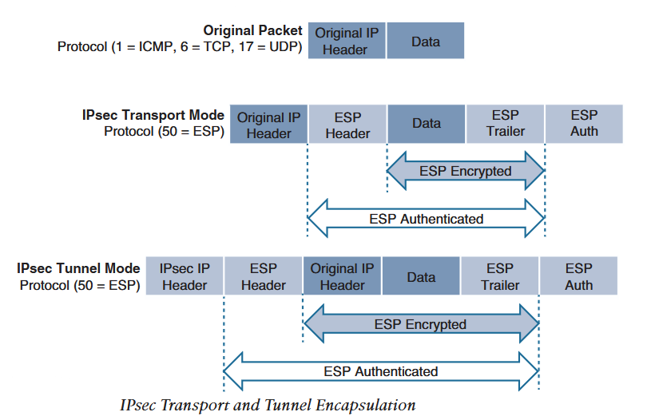
3. IPSec Fundamentals
IPSec encapsulation in two modes:
Tunnel mode: Encrypts whole IP packet along with IP header and adds new IPSec header. New IPSec header is used to provide overlay functions.
Transport mode: Encrypts only payload and uses same IP header to forward packets. This does not provide overlay function.

Slide 10
3. IPSec Fundamentals
IPSec supports below technologies to provide highly secure services
IPSec provides variety of below technologies using transform set
Technologies | Description
Data Encryption Standard (DES) | 56 bit symmetric data encryption technique. This is weak encryption and should be avoided
3DES | Same as DES but uses 3 different keys to encrypt, decrypt and encrypt again before sending. Weak and should be avoided.
Advanced Encryption Standard (AES) | Symmetric encryption developed to replace DES. Supports 128 bits, 196 bits or 256 bits.
Message Digest 5 (MD5) | 128 bit one way hash function to provide authentication and integrity. Cisco uses HMAC version of MD5. Should be avoided and use SHA
Secure Hash Algorithm (SHA) | 160 bit one way has function to provide authentication and integrity. Cisco uses SHA1-HMAC to prevent MitM. Variety includes SHA256, SHA384 and SHA 512
Diffie-Hellman (DH) | Asymmetric key exchange protocol that enables two endpoints to create/exchange a key used by encryption algorithm such as AES over an unsecure channel. DH group refers to length of key (modulus size) used to create a key. Ex. Group 2 is 1024 bits long. Cisco recommends using groups 14 or higher. DH based on Elliptic Curve is known as ECDH.
RSA Signatures | Public-key (digital certificates) cryptographic system used to mutu-ally authenticate the peers.
Pre-Shared Key | Authentication mechanism where locally configured key is used to mutually authenticate peers.

Slide 11
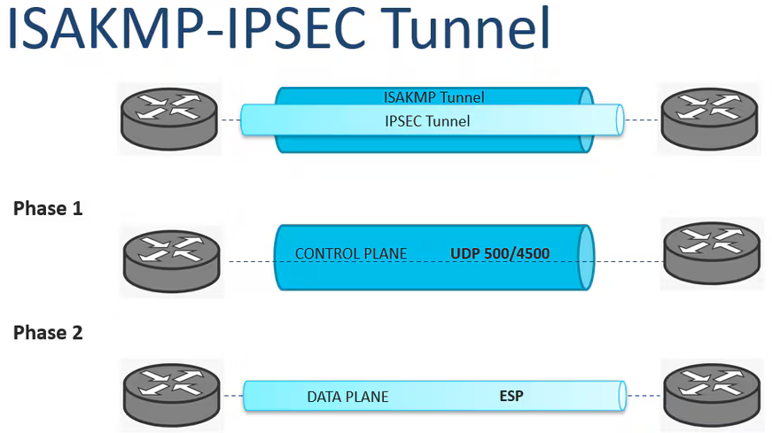
3. IPSec Fundamentals
Internet Key Exchange (IKE) is a protocol that authenticates two endpoints to establish Security Associations (SA) also known as IKE tunnel.
Internet Security Association Key Management Protocol (ISAKMP) is a framework for authentication and key exchange between peers to establish, modify and tear down SAs.
IKE is Cisco's implementation of ISAKMP framework to provide services defined in ISAKMP using Oakley and SKEME key exchange techniques.
For Cisco IKE and ISAKMP are interchangeable.
IKE has two versions: IKEv1 and IKEv2
IKEv1/ISAKMP Deepdive ?
Defines two phases of key negotiation and IPSec establishment
Phase 1: Protects control plane packets such as negotiation, keepalive or information packages by creating ISAKMP tunnel.
Uses UDP port 500/4500 to establish ISAKMP tunnel.
Creates a bi-directional SA between peers known as ISAKMP SA
Then any peer can initiate negotiations for phase 2 (IPSec SA)
Security Parameter Index (SPI) identifies SA between peers.
Notes:
A protocol is the communication rule set governing how nodes exchange data, while a framework is the more generalized structural foundation or software architecture that organizes those protocols. Protocol based on low level frameworks can be nested/used to provide another framework providing more services than the one nested. Protocol are implementation of a framework.
IPSec detailed explanation

Slide 12
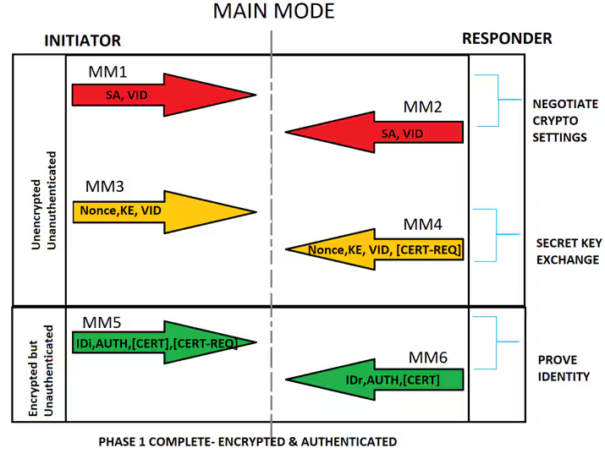
3. IPSec Fundamentals
Main Mode (MM) : Six messages exchanged between pairs to establish ISAKMP SA.
MM1: First message initiator (Init SPI : random value) sends to responder (resp SPI: all zeroes) that includes one or more proposals defined as ISAKMP policy. Responder should match at least one proposal. The Policy contains:
An encryption method, to protect the data and ensure privacy. (AES 256, AES 384)
An authentication method (Pre-shared key or digital certificates)
A Hashed Message Authentication Codes (HMAC) method to ensure the identity of the sender, and to ensure that the message has not been modified in transit. (SHA1)
A Diffie-Hellman group to determine the strength of the encryption-key-determination algorithm. The security appliance uses this algorithm to derive the encryption and hash keys. (DH Group 14)
A limit to the time the security appliance uses an encryption key before it gets replaced. This does not need to be same on both peers. One with less lifetime is used.

Slide 13
3. IPSec Fundamentals
MM2: Responder sends the selected policy for the proposals matched, and the responder SPI is set to a random value.
MM3: Based on responder match in MM2, Initiator starts DH key exchange.
MM4: Responder sends its own DH public key to initiator. Both peer calculate symmetric DH key after this step.
MM5: Initiator Authenticates itself with responder by sending it's ID/IP address and agreed authentication parameters in MM1 and MM2. This message is encrypted with symmetric DH key generated in above step.
MM6: Responder authenticates itself by sending exactly same encrypted packet as MM5 to initiator but with its own parameters.
VID: Vendor ID (feature support)
KE: Key Exchange
IDi/IDr: ID initiator, ID responder

Slide 14
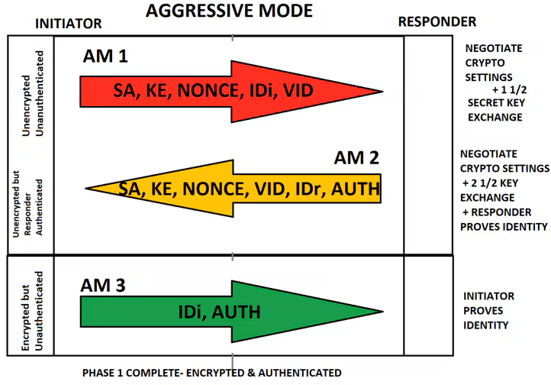
3. IPSec Fundamentals
Aggressive Mode (AM) : 6 messages from MM are compressed into 3 message exchanges between peers to establish ISAKMP SA.
AM1: Initiator combines information sent in MM1, MM2, MM3 & MM5 and sends it as AM1.
AM2: Responder combines information sent in MM2,MM4 and MM6 and sends it as AM2. Both peers can create DH secret key after this message exchange. IDr and AUTH unencrypted.
AM3: Initiator sends its ID and authentication parameter to authenticate. Packet similar to MM5.
Aggressive mode is quicker than Main Mode, but sends ID and authentication parameters in clear text.

Slide 15
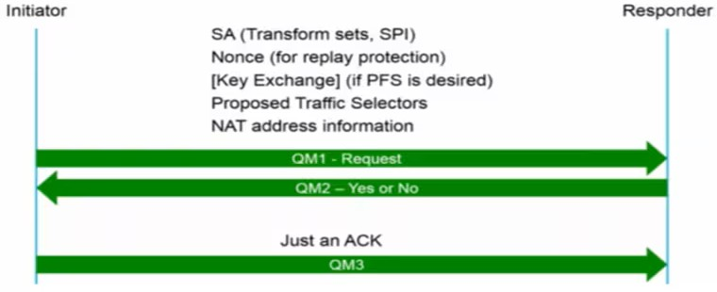
3. IPSec Fundamentals
Quick Mode (QM) : After phase 1 is completed, Phase 2 (IPSec SA establishment) is started by exchanging 3 Quick Mode messages. Phase 1 is bidirectional SA, thus any peer can initiate phase 2. After phase 2 is completed, two unidirectional IPSec SAs are created.
QM1:This message includes agreed-upon algorithms for encryption and integrity decided as part of phase 1, as well as what traffic is to be encrypted or secured .
QM2: This message from the responder has matching IPsec parameters
QM3: After this message, there should be two unidirectional IPsec SAs between the two peers.
Perfect Forward Secrecy (PFS) is a key generation mechanism that is independent of previously generated keys. Thus, even if any previous keys were compromised no future keys will be compromised.
Minimum messages to establish secure IPSec SA: ​
6 MM and 3 QM = 9​
3 AM and 3 QM = 6

Slide 16
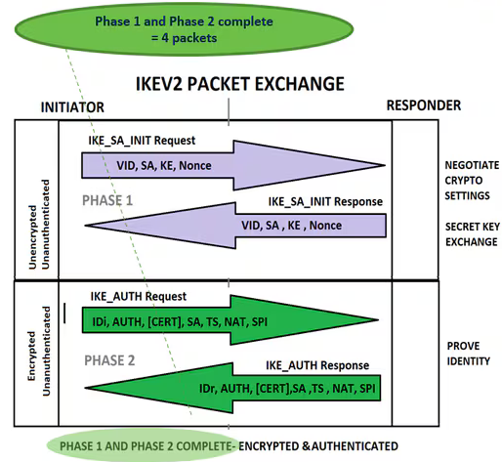
3. IPSec Fundamentals
IKEv2 : Developed to overcome limitations of IKEv1.
Messages exchanged as request and response pairs.
Total four messages exchanged to complete both phase 1 and phase 2.
IKE_SA_INIT pairs exchanges SA (Cryptographic algo), Key (DH public key), nonce and features supported.
IKE_AUTH pairs exchanges IDs, Authentication parameters and Transform Set (TS) encrypted with DH symmetric key derived in first pair exchange.
With this four messages, it establishes a bidirectional IKE SA and unidirectional child SA (IPSec SA).
If any further IPSec SAs are required, they exchange CREATE_CHILD_SA pairs. (request & response)
For Notification, SA Deletion and Configuration during IPSec session, INFORMATIONAL exchange pairs are used.
Because of message format and numbers IKEv1 and IKEv2 are incompatible.

Slide 17
3. IPSec Fundamentals
Cisco IPSec VPN Types:
Site-to-Site IPSec VPN : Multivendor support, difficult to manage in large deployments
Dynamic Multipoint VPN (DMVPN) : Simplifies configuration for hub-and-spoke and spoke-to-spoke VPNs. Uses multipoint GRE (mGRE), Next Hop Resolution Protocol (NHRP) and IPSec.
Group Encrypted Transport (GET) VPN : Enterprise grade VPN over private transport network(underlay) such as MPLS. Good for regulatory requirements to encrypt data in private WAN networks.
FlexVPN : IKEv2 based VPN solution that provides variety of VPN topologies (remote access, site-to-site, Hub-and-spoke, and partial meshes spoke-to-spoke).
Remote VPN : Remote workers securely VPN into corporate network. Supported on IOS with FlexVPN, ASA 5500 X and FirePOWER.

Slide 18
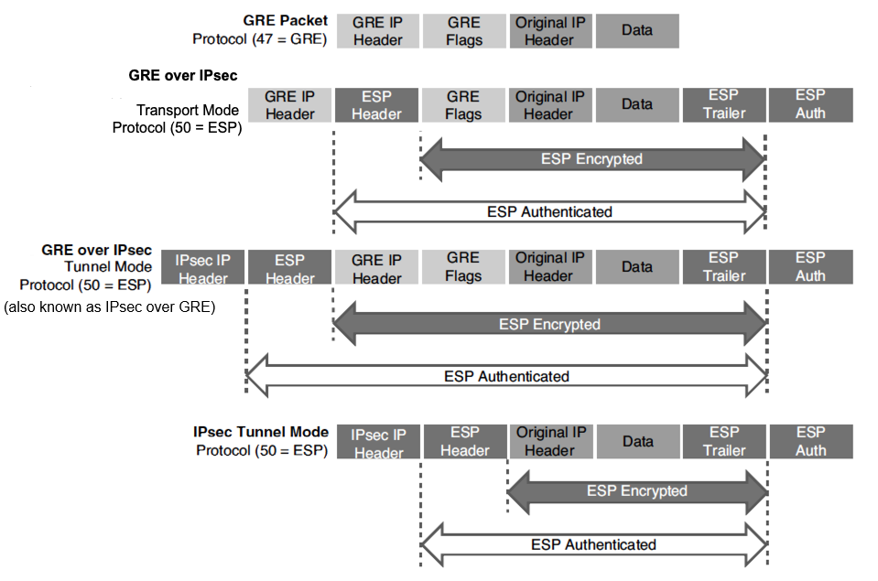
3. IPSec Fundamentals
Site-to-Site IPSec VPN
GRE over IPSec: GRE over IPSec with transport mode is used mostly, as there is no double header (GRE IP & IPSec).
GRE over IPSec Tunnel mode (IPSec over GRE) has (GRE IP & IPSec header) thus not recommended.

Slide 19
3. IPSec Fundamentals
GRE over IPSec can be configured in two ways:
Using Crypto map : This method is old but still deployed. It requires ACLs and Crypto Maps to be created. Which are then applied to physical interfaces (underlay interfaces) of the tunnel.
IPSec profile : This is recommended method of creating GRE over IPSec VPN. This method is straight forward as it does not require ACLs and Crypto Maps. IPSec profile is applied under tunnel configuration.
Static Virtual Tunnel Interface (SVTI) over IPSec:
This VPN tunnel is created with virtual tunnel interface in IPSec over IPv4/IPv6 mode.
The IPSec profile is then applied to VTI.

Slide 20
4. LISP
A Default-Free Zone (DFZ) is number/collection of routers connected to internet that does not rely on default routes.
Instead they run routing protocol such as BGP and has Full Internet Routing Table (FIRT) updates (around 1 million route entries).
Challenges
Aggregation Issues: Routes on FIRT come from variety of AS, thus cannot be aggregated to reduce IRT size.
Traffic Engineering: Injecting more specific routes into FIRT for ingress traffic manipulation makes aggregation harder.
Multihoming: Even small site multihoming would require router that can hold FIRT.
Routing Instability: Routing instability in FIRT requires powerful routers.

Slide 21
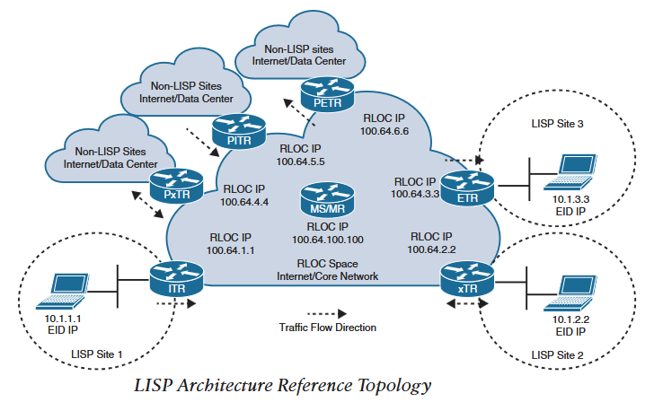
4. LISP
Solution :
New paradigm that uses Endpoint Identifier and Routing locator (EID,RLOC) to identify endpoints in the network.
Key Terms | Description
Endpoint ID (EID) | IP (IPv4/IPv6) address of the endpoint.
LISP Site | Site where LISP EIDs and routers reside
Ingress Tunnel Router (ITR) | LISP routers that LISP-encapsulate IP packets coming from EID and destined out of LISP site.
Egress Tunnel Router (ETR) | LISP routers that de-encapsulate LISP packets coming from outside the LISP site and are destined to EIDs in the LISP site.
Tunnel Router (xTR) | Routers that perform both ITR and ETR functions.
Proxy ITR (PITR) | ITRs in non-LISP site that forward traffic to EIDs.
Proxy ETR (PETR) | ETRs at non-LISP site that receive LISP packets and deliver to destinations at non-LISP site.
Proxy xTR (PxTR) | Routers that perform both PITR and PETR functions.
RLOC | IP address of LISP router that has ETR functions.
Map Server (MS) | Learns EID-to-Prefix mapping from ETR and stores in local EID-to- RLOC mapping database.
Map Resolver (MR) | Receives LISP encapsulated map requests from ITR and finds ETR to answer those requests by consulting MS
MS/MR | Device that has both MS and MR implemented

Slide 22
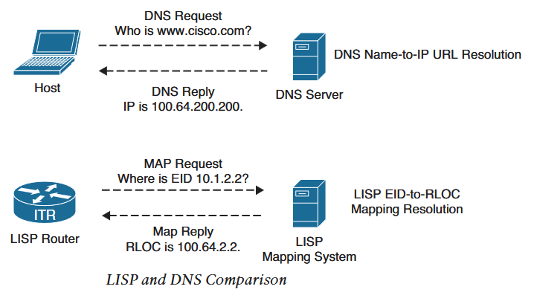
4. LISP
Routing Architecture
In traditional routing endpoint's IP address represents its identity and location in the network.
LISP separates IP addresses as (EID,RLOC), If endpoint roams/changes location, it's RLOC changes but EID remains same.
Control Plane
Operates similar to DNS system.
LISP can resolve EID to RLOC by sending map request to MR.
Thus, similar to DNS, LISP operates in pull model. Only required info is requested and is on demand.
Traditional routing operates in push model as they advertise everything irrespective of information relevance.

Slide 23
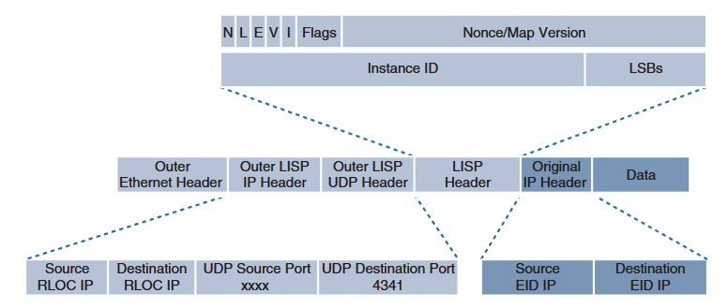
4. LISP
Data Plane
Original IP packet (IP header +payload) is encapsulated with IP/UDP header forming a IP-in-IP/UDP encapsulation.
Outer IP/UDP header is called Outer Header (OH) and original IP packet is called Inner Header (IH).
IH contains IP addresses of EIDs, OH contains IP addresses of ITR & ETR from RLOC space.
LISP uses UDP destination port 4341 for data transmission.
Outer LISP UDP source port is tactically selected by ITR to make sure load sharing in ECMP.
Instance ID in LISP Header is a 24 bit field that provides device and path level network virtualization.
As LISP supports both ipv4 and ipv6 passenger and transport protocol, combination of ipv4 EID in ipv4 RLOC, ipv4 EID in ipv6 RLOC, ipv6 EID in ipv6 RLOC and ipv6 EID in ipv4 RLOC encapsulation is supported.
LISP Packet Format

Slide 24
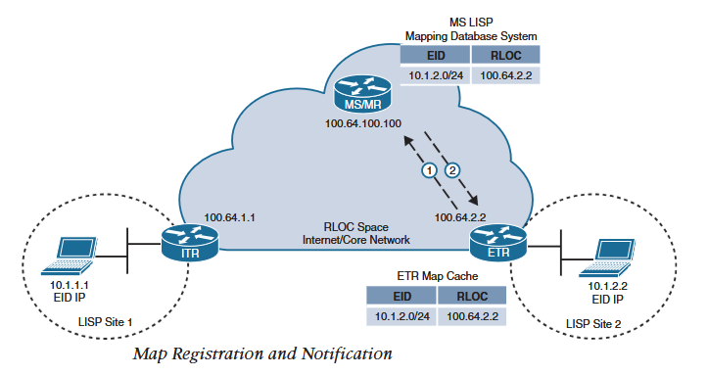
4. LISP Operation
Map Registration and Notification
ETR router needs to be configured with prefixes of EIDs within the site.
Any EIDs prefixes not registered with ETR are forwarded natively (underlay).
ETR sends Map-Register message to MS to register it's LISP prefix 10.1.2.0/24 .In addition, it instructs MS to forward Map-Requests for EIDs in that prefix to its RLOC (100.64.2.2) and may set proxy map reply flag (P-bit) to act as proxy for itself.
MS sends Map-Notify message to ETR to notify that the Map-Register message has been received and processed. Map-Notify message has both source and destination UDP port 4342.

Slide 25
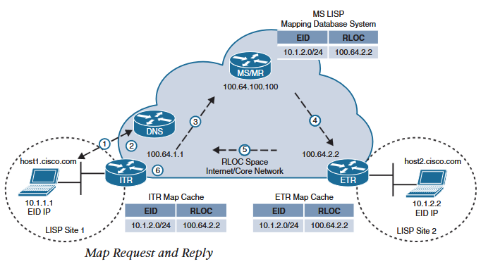
4. LISP Operation
Map Request and Reply
Within the LISP site, traditional routing with IGP is used to forward the packets until it reaches ITR.
For a packet destined out of the LISP site, below steps are followed:
Host1 sends DNS request for host2 and receives host2's EID (10.1.2.2). Packet from host1 destined for host2 reaches ITR (default gateway for host1).
When ITR receives that packet it performs FIB lookup and evaluates following rules:
Did the packet match default route as there is no more specific route to 10.1.2.2?
If Yes, continue to next step.
If No, forward it natively using the matched route.
Is the source ip registered EID prefix in local cache?
If Yes, continue to next step.
If No, forward it natively using the default route.

Slide 26
4. LISP Operation
Map Request and Reply
3. ITR sends a Map-Request message to MS for destination 10.1.2.2 . The Map-Request message UDP destination port is 4342 and source port is chosen by ITR.
4. MS/MR forwards the Map-Request to Authoritative (source of truth) ETR. If MR and MS are on separate device, then ITR sends to MR, MR sends to MS and MS sends to ETR.
5. ETR sends a Map-Reply message to ITR with EID-to-RLOC (10.1.2.2 -to-100.64.2.2) mapping. Map-Reply message source port is 4342 and destination port as chosen by ITR in Map-Request message.
6. ITR caches the EID-to-RLOC mapping and programs it's FIB accordingly to start forwarding LISP traffic for this path.

Slide 27
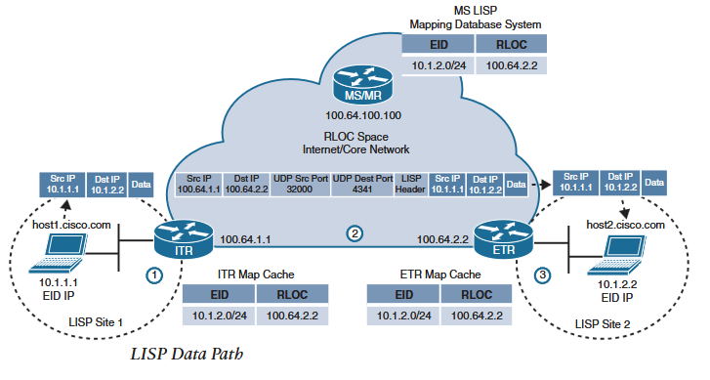
4. LISP
LISP Data Path
Once ITR receives EID-to-RLOC mapping from ETR or MS (if ETR set proxy map-reply flag P-bit in Map-Register), LISP traffic takes below data path:
ITR receives a packet from EID host1 (10.1.1.1) destined to 10.1.2.2 .
ITR does FIB lookup and finds a match. It encapsulates received packet with Outer Header (OH) with source IP as ITR's RLOC (100.64.1.1) destination IP as ETR's RLOC (100.64.2.2). ITR selects UDP source port tactically to make sure load sharing in ECMP and UDP destination port as 4342.
ETR receives the packet and de-encapsulates and forwards it to 10.1.2.2 .

Slide 28
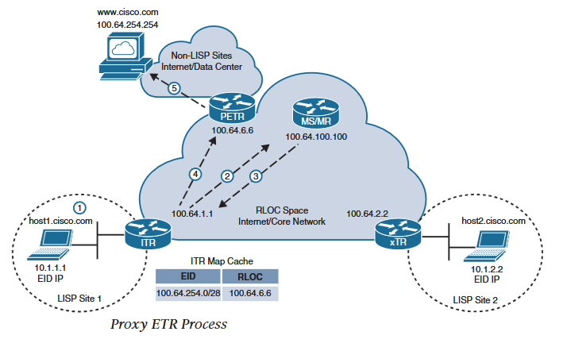
4. LISP
Proxy ETR (PETR)
PETR connects non-LISP site to RLOC space and does not register any EIDs.
ITR that sends Map-Request message for EIDs that are not registered in MS database receive Negative-Map-Reply message.
Negative-Map-Reply message contains shortest prefix that matches the requested destination.
ITR installs the prefix in its local cache and FIB, so that any destination matching the prefix are forwarded to PETR directly.
Following steps are followed to forward traffic to non-LISP site through PETR:
Host1 receives destination address 100.64.254.254 for cisco.com from DNS.
ITR sends Map-Request for 100.64.254.254 to MS
ITR receives Negative-Map-Reply with calculated shortest prefix.
ITR now sends encapsulated packets to PETR
PETR de-encapsulates the packet and sends to cisco.com
How does cisco.com reply?

Slide 29
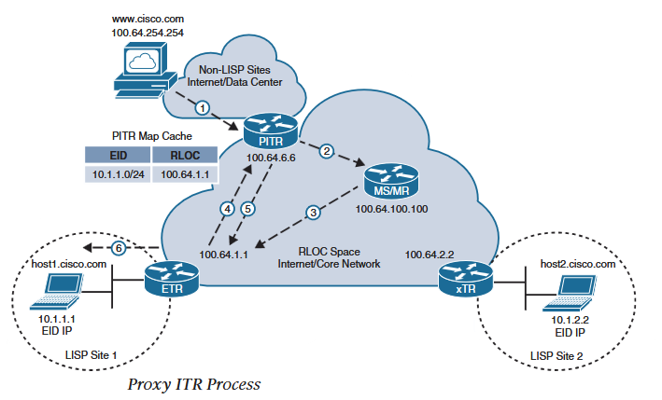
4. LISP
Proxy ITR (PITR)
PITR connects non-LISP site to RLOC space and does not register any EIDs.
They receive packets from non-LISP site destined for EIDs.
Unlike ITR, PITR does not follow Map-Request Reply steps 1 & 2. Step 3 onwards is followed exactly.
Following steps are followed to forward traffic from non-LISP site through PITR:
Traffic/Reply from cisco.com is received by PITR destined for 10.1.1.1
PITR sends Map-Request to MR for 10.1.1.1
MS forwards the Map-Request to ETR.
ETR sends Map-Reply message with EID-to-RLOC (10.1.1.1-to-100.64.1.1) to PITR. It installs the mapping into local cache and FIB.
PITR sends encapsulated LISP packet to ETR.
ETR de-encapsulates the packet and forwards it to 10.1.1.1 .

Slide 30
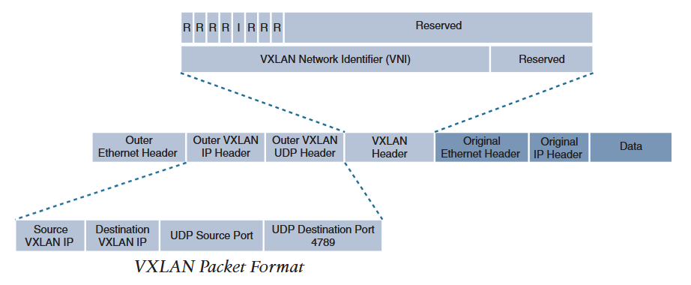
5. VXLAN
Server virtualization has increased the number of VMs in a bare metal server and thus the increase in number of MAC addresses.
VXLAN is an overlay technology that extends layer 2 and layer 3 services over a layer 3 underlay by encapsulating packets with MAC-in-IP/UDP.
Internet Association of Number Assignment (IANA) has assigned UDP destination port 4789.
Whereas Linux uses port number 8472 as it started using before IANA assigned UDP port for VXLAN.
Unlike VLAN ID that has only 12 bits, VXLAN has 24 bit for VXLAN Network Identifier (VNI) that allows for 16 million overlay networks within same infrastructure.
The VNI located in VXLAN shim header encapsulates the original ethernet frame originated by end device.

Slide 31
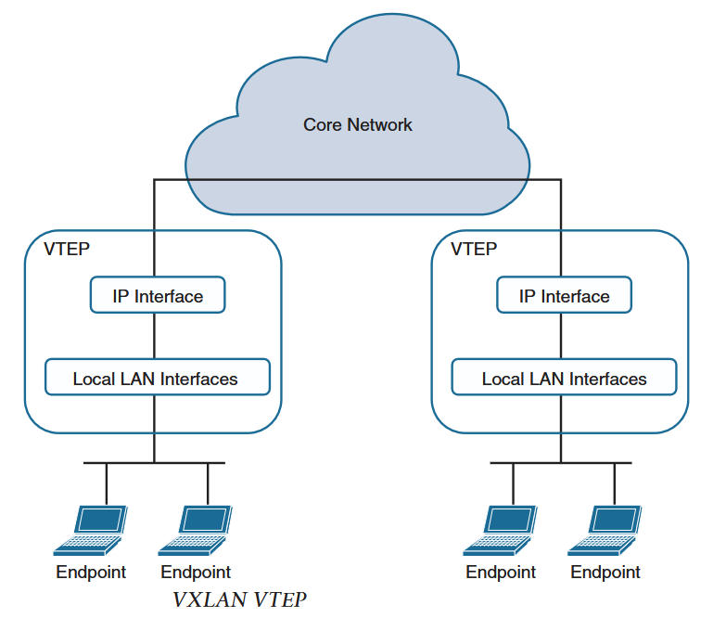
5. VXLAN
To facilitate the discovery of VNI located in shim VXLAN header in between Outer IP/UDP header and inner ethernet header, Virtual Tunnel Endpoints (VTEPs) are used.
A VTEP has two types of interface :
IP interface: Core facing network interface for VXLAN. This interface encapsulates and de-encapsulates VXLAN traffic and helps to identify VTEP in the network.
Local LAN Interfaces : Interfaces that provide bridging between local endpoints.
A VXLAN gateway is a type of VTEP that combines traditional VLAN and VXLAN into a common layer 2 segment for devices that do not support VXLAN.

Slide 32
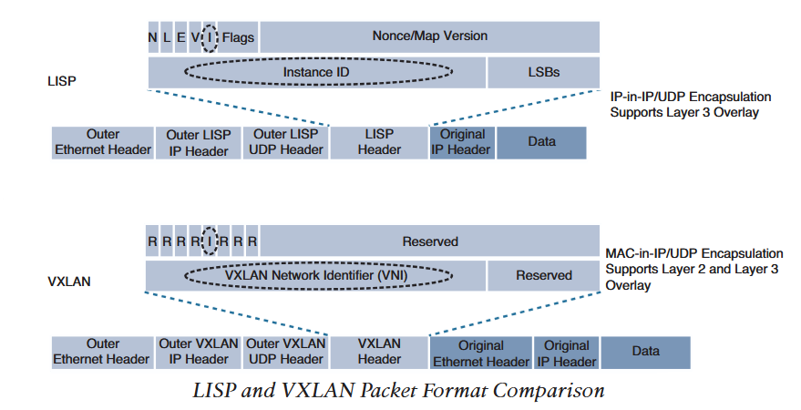
5. VXLAN
VXLAN is data plane only protocol and has no control plane defined, so that it can be used with other overlay control plane such as :
VXLAN with multicast underlay
VXLAN with static unicast VXLAN tunnels
VXLAN with MP-BGP EVPN
VXLAN with LISP control plane
VXLAN with MP-BGP EVPN and Multicast are mostly used in data center and service provider environments.
VXLAN with LISP control plane is preferred for campus environments.
Cisco Software Defined Access (SDA) is an implementation of VXLAN with LISP control plane.
LISP encapsulates IP packet thus only provides layer 3 overlay.
Whereas VXLAN encapsulates ethernet frame thus can provide both layer 2 and layer 3 overlay.
VXLAN is designed from LISP layer 2 specification and the packet structure of two looks similar with VXLAN header field that were not imported from LISP are left as reserved.​

